Slide 1
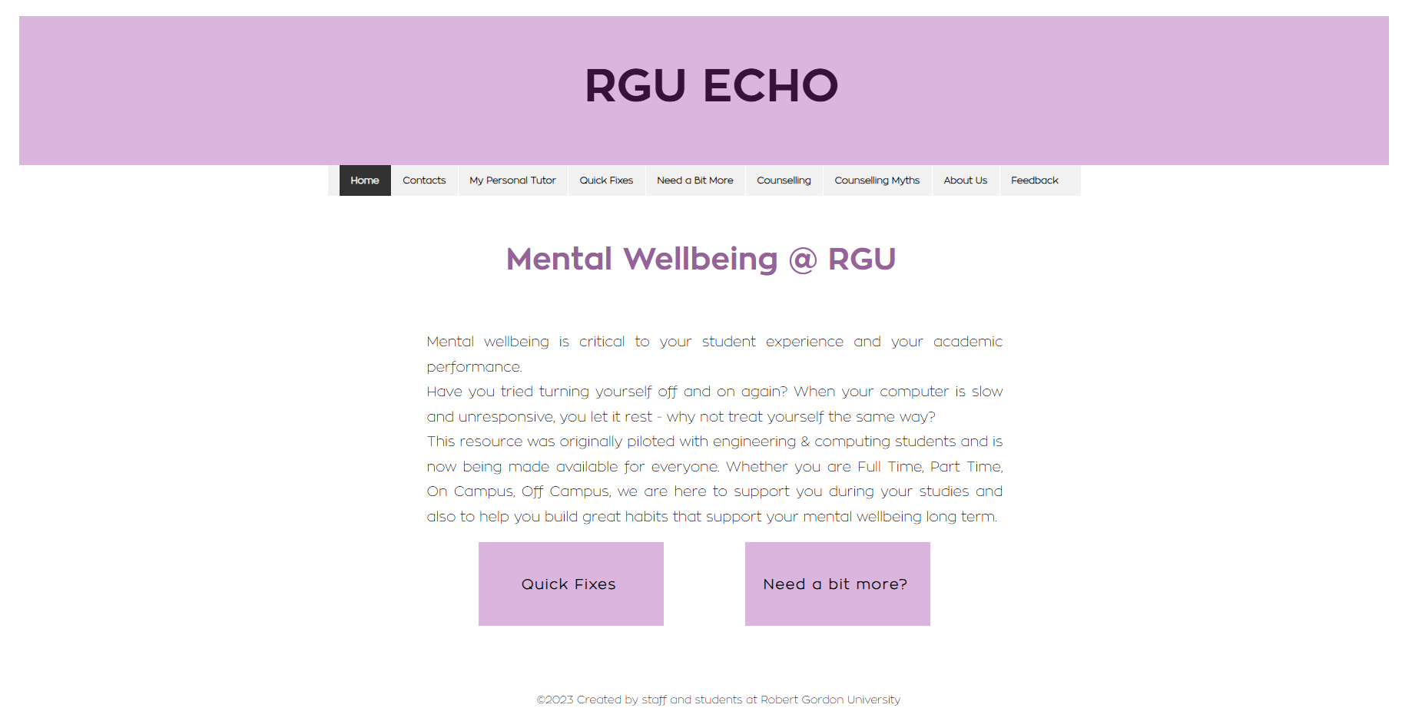
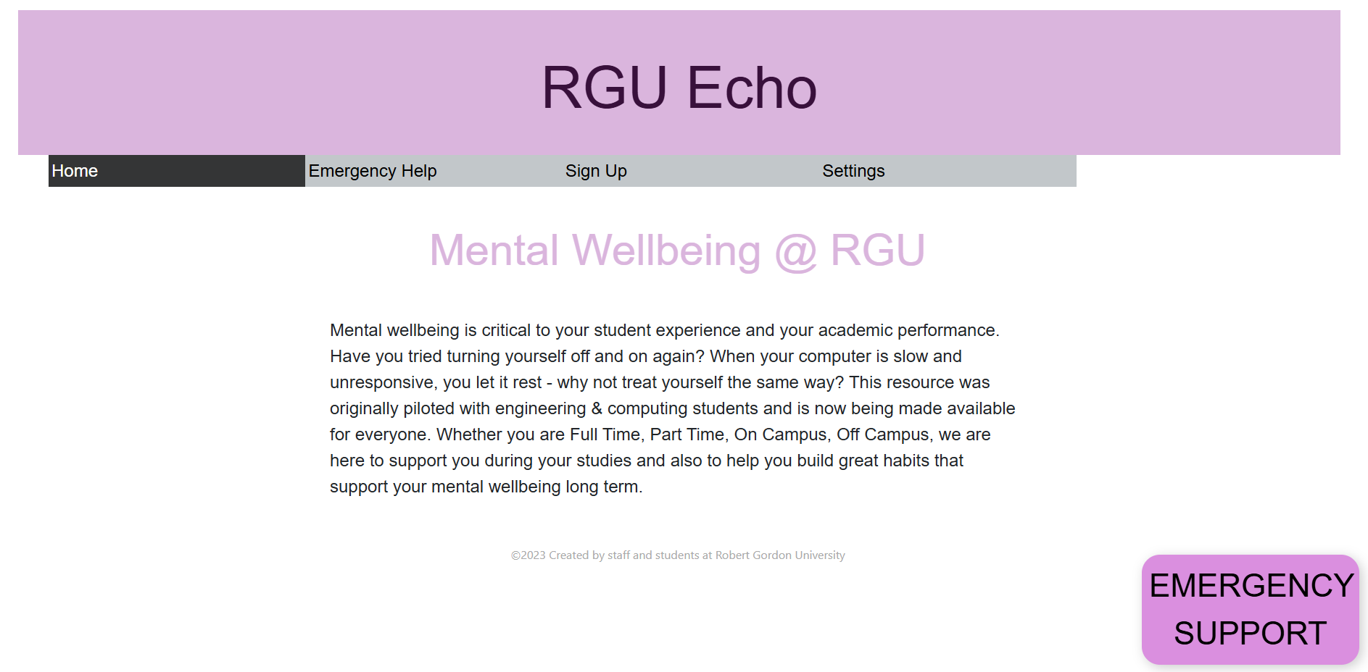
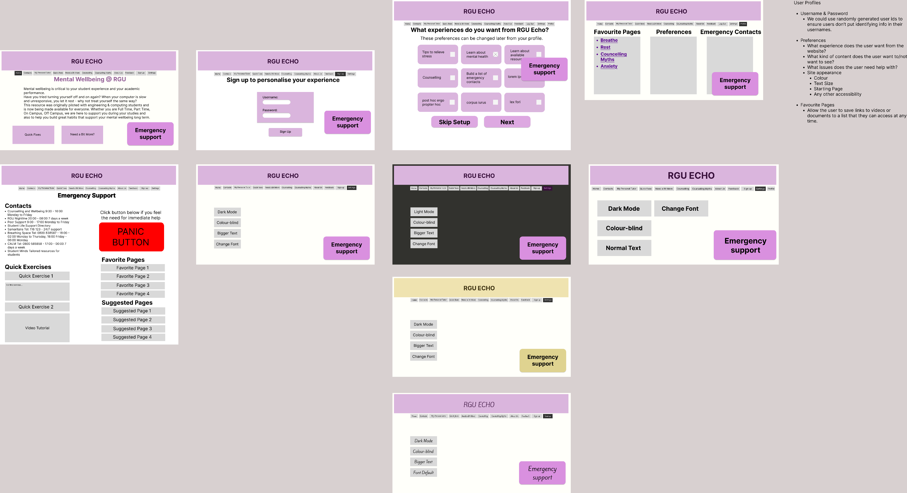

Breadbox
Client: Jo
Members: Emmanuel Friday Ugwu, Jack Thompson, Kieran Dingwall, Onyekachi Obiora, Ryan Jones, Stuart Lancaster
Client Brief
Collaboration & Interdisciplinary Teamwork
Created to address and help the mental health of students at RGU, Echo originally provided resources to help engineering and computing students but is now open to everyone who needs it. Echo provides exercises designed to help students, such as breathing exercises, and provides help for other issues ranging from anxiety and depression to issues with addiction or problems with sleep. There are also pages about counselling, and contacts for help.
As a group, we have made a joint effort to develop a front-ended website which fits the requirements of the client. To achieve this, we had to come together from our different computing backgrounds to all contribute to the final project.
We worked well as a group by effectively delegating tasks to group members and making sure every group member played their part. Group members from the computing science background worked on the front-end prototype and coding, while the cyber security researched security guidelines that our site would have to follow and made sure that they were implemented into the code. Everyone in the group checked on each other’s progress to make sure that we progressed at a speed that would allow us to have a finished final product.
The project is still in its early stages though, and Jo is looking to continue expanding the app. Among the ideas presented for expanding and improving the site, the accessibility of it as well as its security stood out as the most important things that we should be looking at to tackle.
Technical Details
Our prototype was developed using Figma. We based it on the already existing Wix site for Echo, and one of our priorities was trying to stay as faithful to the original design as possible. We didn’t want to over complicate things. We then created front end web pages based on our Figma prototype using HMTL, JavaScript and CSS. The accessibility features were added using JavaScript functions tied to buttons, normally using the onclick() method to trigger a change to the browsers local CSS file.
Implemented Solution
Once we had agreed upon the areas we should be focusing on, we conducted research on accessibility features as well as cyber security before coming together and developing a prototype of what these new features could look like.
With work on the prototype complete, we showed it to our client and then took her feedback to create some web pages to better show what these features could look like.
Conclusions & Future Plans
Working on this project has been a very informative experience into the process of agile development. Overall, the project ran smoothly other than a setback at the beginning due to overestimation of the time we had available to us. This gave us a valuable insight into agile development and the sprint process. In future, we would look to fully recreate the site with our own creative twist while making the site mobile friendly and sticking to client requirements.
We would also look at fleshing out the accessibility features with more options to create as comfortable of a user experience as we can. Further, we would develop a fully secure back-end system including a database to store data, such as user preferences and favourites, anonymously. We would also look at adding a chatbot and possibly a forum to the site to allow interaction between users.

